Slide 1
Database Design

Slide 2
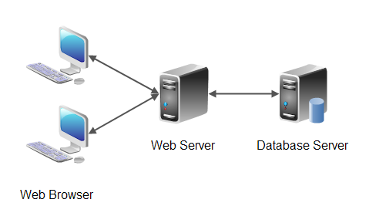
What is a database?

Slide 3
Objectives of a database
Fast reads
Fast writes
Persistent data

Slide 4

Quick comment about disks
Generally, we are using hard drives
Results in slow random reads
We should always aim for sequential operations
Much cheaper than SSDs but slower

Slide 5
Naive Database Implementation
Literally just a list, O(n) reads and updates
Id | Name | Favorite Color
1 | Alan Turing | Red
2 | Mark Zuckerberg | LightBlue
3 | Tech Lead | Doesn’t see color
4 | Mitch McConnell | White

Slide 6
Naive Database Implementation
Literally just a list, O(n) reads and writes
Id | Name | Favorite Color
1 | Alan Turing | Red
2 | Mark Zuckerberg | LightBlue
3 | Tech Lead | Doesn’t see color
4 | Mitch McConnell | White

Slide 7
Naive Database Implementation
Literally just a list, O(n) reads and writes
Id | Name | Favorite Color
1 | Alan Turing | Red
2 | Mark Zuckerberg | LightBlue
3 | Tech Lead | Pink
4 | Mitch McConnell | White

Slide 8
Slightly Better Database Implementation
Append only log on disk to take advantage of sequential logs
Id | Name | Favorite Color
1 | Alan Turing | Red
2 | Mark Zuckerberg | LightBlue
3 | Tech Lead | Doesn’t see color
4 | Mitch McConnell | White

Slide 9
Slightly Better Database Implementation
Append only log on disk to take advantage of sequential logs
Id | Name | Favorite Color
1 | Alan Turing | Red
2 | Mark Zuckerberg | LightBlue
3 | Tech Lead | Doesn’t see color
4 | Mitch McConnell | White
3 | Tech Lead | Pink

Slide 10
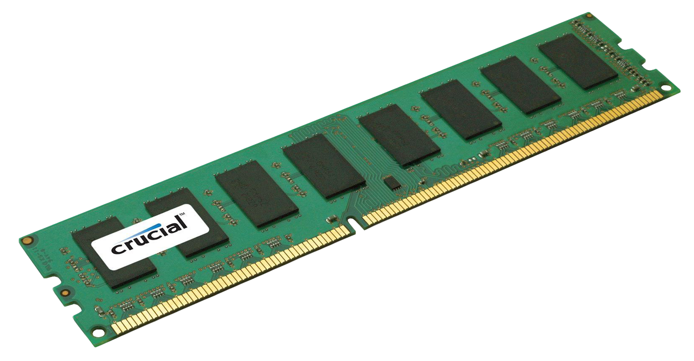
Better database implementation
Hashmap, O(1) reads and writes
However, this does not scale because the second there is too much data we are in trouble, hashmap has to go on disk which becomes slow

Slide 11
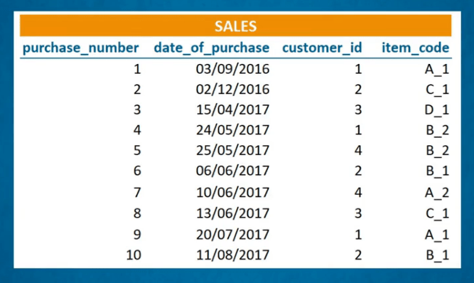
Indexes - making read times much faster
Keep extra data on each write to improve database read times
Pro: Faster reads
Con: Slower writes (only use indexes if you need them, do not declare an index for every field)

Slide 12
Types of index implementations
Hash Indexes
LSM trees + SSTables
B Trees

Slide 13
Hash Index
Keep an in memory hash table of the key mapped to the memory location of the corresponding data, occasionally write to disk for persistence
Pros: Easy to implement and very fast (disks are slow, RAM is fast)
Cons: All of the keys must fit in memory, bad for range queries
Key | Offset on Disk
jordan | 0x04444511
kobe | 0x01112365
lebron | 0x06128989

Slide 14
SSTables and LSM trees
Write first goes to an in-memory balanced binary search tree (memtable), eventually written to disk
4: brees
When tree becomes too large, write the contents of it (sorted by key name) to an SSTable file
2: manning
5: montana
1: brady
3: rodgers
6: favre
To increase persistence, keep log on disk of memtable writes to restore it in the event of a crash.

Slide 15
SSTables and LSM trees
Write first goes to an in-memory balanced binary search tree (memtable), eventually written to disk
4: brees
When tree becomes too large, write the contents of it (sorted by key name) to an SSTable file
2: manning
5: montana
1: brady
3: rodgers
6: favre
7: young
To increase persistence, keep log on disk of memtable writes to restore it in the event of a crash.

Slide 16
SSTables and LSM trees continued
Recall: Tree gets written to SSTable files, where the keys are sorted
SSTable file 1
SSTable file 2
0 | Westbrook
7 | Anthony
9 | Wade
23 | Jordan
33 | Jabbar
34 | Olajuwon
3 | Iverson
5 | Garnett
13 | Harden
23 | Lebron
33 | Pippen
34 | Giannis

Slide 17
SSTables and LSM trees continued
Recall: Since we are only using append only logs, there will be duplicate keys
SSTable file 1
SSTable file 2
0 | Westbrook
7 | Anthony
9 | Wade
23 | Jordan
33 | Jabbar
34 | Olajuwon
3 | Iverson
5 | Garnett
13 | Harden
23 | Lebron
33 | Pippen
34 | Giannis

Slide 18
SSTables and LSM trees continued
Recall: Since we are only using append only logs, there will be duplicate keys
SSTable file 1
SSTable file 2
Compacted SSTable
0 | Westbrook
7 | Anthony
9 | Wade
23 | Jordan
33 | Jabbar
34 | Olajuwon
3 | Iverson
5 | Garnett
13 | Harden
23 | Lebron
33 | Pippen
34 | Giannis
0 | Westbrook
3 | Iverson
5 | Garnett
7 | Anthony
9 | Wade
13 | Harden
23 | Lebron
33 | Pippen
34 | Giannis

Slide 19
SSTables and LSM trees continued
Can be merged in O(n) time, in case of duplicate key take the more recent value
SSTable file 1
SSTable file 2
Compacted SSTable
0 | Westbrook
7 | Anthony
9 | Wade
23 | Jordan
33 | Jabbar
34 | Olajuwon
3 | Iverson
5 | Garnett
13 | Harden
23 | Lebron
33 | Pippen
34 | Giannis
0 | Westbrook
3 | Iverson
5 | Garnett
7 | Anthony
9 | Wade
13 | Harden
23 | Lebron
33 | Pippen
34 | Giannis

Slide 20
SSTables and LSM trees continued
Let’s discuss how to quickly read a value by its index!
First
MemTable
Second
SSTable n
Third
SSTable n-1
28 | Peterson
44 | Bradshaw
81 | Moss
28 | Taylor
80 | Rice
85 | Gates
4: brees
2: manning
5: montana
1: brady
3: rodgers
6: favre
Keep going through SSTables until you either find the key or run out!

Slide 21
SSTables and LSM trees continued
For each SSTable, have a sparse in-memory hashmap of keys with their value in memory. Since each table is sorted, we can quickly binary search the SSTable to find the value of a key!
In memory hash table
SSTable
Alice | 0x00000000
Bob | 0x00000080
Charlie | 0x000000f0
Alice | 22
Andy | 61
Anna | 40
Bob | 80
Brian | 15
Charlie | 35

Slide 22
SSTables and LSM trees summarized
Pros:
High write throughput due to writes going to in memory buffer
Good for range queries due to internal sorting of data in the index
Cons:
Slow reads, especially if the key we are looking for is old or does not exist
Merging process of log segments can take up background resources

Slide 23
B-Trees
A
REF
E
REF
P
REF
Z
A
REF
C
REF
E
P
REF
T
REF
Z
Thomas
33
Vlad
24
Zeke
50

Slide 24
B-Trees continued
A
REF
E
REF
P
REF
Z
A
REF
C
REF
E
P
REF
T
REF
Z
Thomas
33
Vlad
24
Zeke
50

Slide 25
B-Trees continued
A
REF
E
REF
P
REF
Z
A
REF
C
REF
E
P
REF
T
REF
Z
Thomas
33
Vlad
24
Zeke
50

Slide 26
B-Trees continued
A
REF
E
REF
P
REF
Z
A
REF
C
REF
E
P
REF
T
REF
Z
Thomas
33
Vlad
24
Zeke
50

Slide 27
B-Trees continued
To read: traverse through the tree and find the value
To update: traverse through the tree and change the value
To write: traverse through the tree, if there is extra space in the block where the value belongs, add the key, otherwise you have to split the location block in two, add the key, and then update the parent block to reflect this action. Can be made durable in the event of crashes using a write ahead log.

Slide 28
B-trees summarized
Pros:
Relatively fast reads, most B-trees can be stored in only 3 or 4 levels
Good for range queries as data is kept internally sorted
Cons:
Relatively slow writes, have to write to disk as opposed to memory

Slide 29
Conclusion
In a system, it is important to know what type of database engine/design you are using so that you can optimize for writes or reads.
Hash indexes: fast but only useful on small datasets
SSTables and LSM-Trees: better for writing, slower for reading
B-Trees: better for reading, slower for writing

